Slide 1
Background
Purpose
Datasets
Method
ML System for Remote Sensing
Weili Shi Daiqing Qi
2022-9-14

Slide 2
Background
Computer vision technology achieve great success on benchmark dataset.
Remote sensing technology provides tons of images generated by the satellites.
Before emergence of deep learning, the analysis of the remote sensing images are done manually.
The combination of the two will be so natural and it is a fast-growing field.

Slide 3
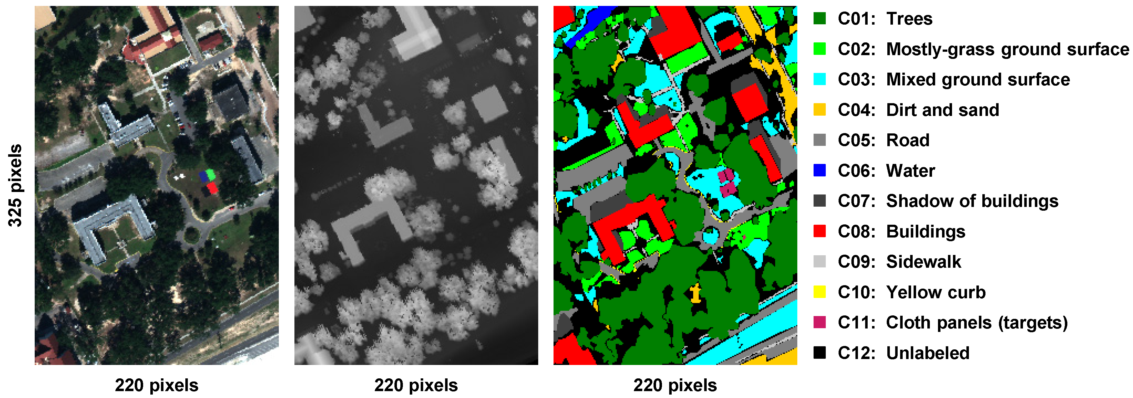
Purpose
We aim to utilize the state-of-the-art computer vison models and algorithms to collect and identify features in an environment with precise accuracy and speed.

Slide 4
Purpose
In our project, we would focus on two major tasks: object detection and semantic segmentation.

Slide 5
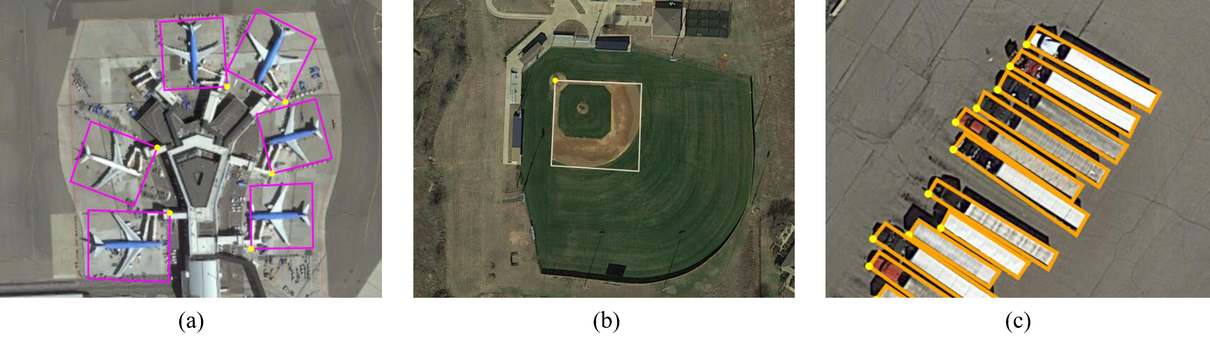
Dataset
DOTA-v1.5: A Large-scale Dataset for Object Detection in Aerial Images. It contains 0.4 million annotated object instances within 16 categories

Slide 6
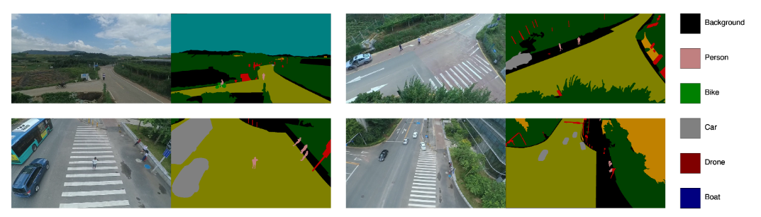
Dataset
AeroScapes aerial semantic segmentation

Slide 7
Method
Transfer learning, we transfer the existing models on new dataset.
The models includes；YOLO for object detection and DeepLab for segmentation
Develop new component specific for remote sensing images

